Slide 1
Asynchrony, multithreading and concurrency

Slide 2
Synchronous, asynchronous and multithreaded programming
Synchronous: you cook the eggs, then you cook the toast.
Asynchronous, single threaded: you start the eggs cooking and set a timer. You start the toast cooking, and set a timer. While they are both cooking, you clean the kitchen. When the timers go off you take the eggs off the heat and the toast out of the toaster and serve them.
Asynchronous, multithreaded: you hire two more cooks, one to cook eggs and one to cook toast. Now you have the problem of coordinating the cooks so that they do not conflict with each other in the kitchen when sharing resources. And you have to pay them.

Slide 3
Synchronous, asynchronous and multithreaded programming
Threading is about workers, asynchrony is about tasks
For processor-bound tasks that includes heavily computing it makes sense to hire as many workers (threads) as there are processors
I/O-bound tasks often require a response from outside sources such as database or service. When making calls to these sources, the processor often has to "wait" for them to respond. Instead of waiting for response asynchronous programming enables us to efficiently use processor time.
Notes:
Asynchronous Is Not Multithreading
In multithreading, work is done on totally separate threads.
In asynchronous programming, we define points from which threads can leave and return to at some point in the future.
Synchronous Programming model – In this programming model, A thread is assigned to one task and starts working on it. Once the task completes then it is available for the next task. In this model, it cannot leave the executing task in mid to take up another task
Asynchronous Programming Model – In contrary to Synchronous programming model, here a thread once start executing a task it can hold it in mid, save the current state and start executing another task.
-------
CPU-bound tasks are tasks which rely on the computation speed of the machine to execute quickly, such as complex mathematical calculations. Said computations will occupy the processor's time, and while they are being executed the processor does not need to wait for any other inputs. These kinds of tasks generally do not benefit from asynchronous programming.
Of course we can combine CPU-bound tasks with asynchronous programming to gain responsiveness (if we have concurrent work to do), but there is better ways to achieve this.

Slide 4
Threading uses and misuses
Most common use scenarios
Be aware
Maintaining a responsive user interface
Making efficient use of an otherwise blocked CPU
Parallel programming
Allowing requests to be processed simultaneously (better throughput and responsiveness)
Harder maintainability and debugging of application
More threads doesn’t mean better performance
Threading introduce new problems (deadlocks, race condition…)
Notes:
Maintaining a responsive user interface
By running time-consuming tasks on a parallel “worker” thread, the main UI thread is free to continue processing keyboard and mouse events.
Making efficient use of an otherwise blocked CPU
Multithreading is useful when a thread is awaiting a response from another computer or piece of hardware. While one thread is blocked while performing the task, other threads can take advantage of the otherwise unburdened computer.
Parallel programming
Code that performs intensive calculations can execute faster on multicore or multiprocessor computers if the workload is shared among multiple threads in a “divide-and-conquer” strategy
Allowing requests to be processed simultaneously
On a server, client requests can arrive concurrently and so need to be handled in parallel (the .NET Framework creates threads for this automatically if you use ASP.NET, WCF, Web Services, or Remoting).

Slide 5
Thread pooling
Whenever we start a thread, a few hundred microseconds are spent organizing such things as a fresh private local variable stack. Each thread also consumes (by default) around 1 MB of memory
The thread pool cuts these overheads by sharing and recycling threads, allowing multithreading to be applied at a very granular level without a performance penalty
There are a number of ways to enter the thread pool:
  By calling ThreadPool.QueueUserWorkItem
  Via asynchronous delegates
  Via the Task Parallel Library (from Framework 4.0)
  Via BackgroundWorker
Examples with source code are available in AsynchronyThreadingDemo application (options 1-4)

Slide 6
Thread pooling
Via Task Parallel Library
With Task class from Task Parallel Library we can easily enter the thread pool
Task classes were introduced in .NET Framework 4.0
Nongeneric Task class is a replacement for ThreadPool.QueueUserWorkItem
Generic Task<T> is a replacement for asynchronous delegates
Task.Factory.StartNew
Examples with source code are available in AsynchronyThreadingDemo application (option 3)
Notes:
A task is simply an object that represents that a value will become available in the future and can run code (on the correct thread) when that value is available.

Slide 7
Exceptions handling
Any try/catch/finally blocks in scope when a thread is created are of no relevance to the thread when it starts executing.
Each thread has an independent execution path.
You need an exception handler on all thread entry methods in production applications
The “global” exception handling events for WPF (Application.DispatcherUnhandledException) fire only exceptions thrown on the main UI thread. You still must handle exceptions on worker threads manually.
AppDomain.CurrentDomain.UnhandledException fires on any unhandled exception but provides no means of preventing the application from shutting down afterward.
Examples with source code are available AsynchronyThreadingDemo application (options 5-9)

Slide 8
How to update UI?
Executing long-running operations on the main thread make the application unresponsive
Popular approach is to start up worker threads or time-consuming operations and then update UI when work is complete
All rich-client applications have a threading model whereby UI elements and controls can be accessed only from the thread that created them (typically the main UI thread)
Violating this causes unpredictable behavior, or an exception to be thrown
To forward request to the UI thread in WPF we would have used Dispatcher.BeginInvoke or Dispatcher.Invoke

Slide 9
System.Threading.Thread
A thread is a low-level tool for creating concurrency, and as such it has limitations.
While it’s easy to pass data into a thread that you start, there’s no easy way to get a “return value” back from a thread that you Join. You have to set up some kind of shared field. And if the operation throws an exception, catching and propagating that exception is equally painful.
You can’t tell a thread to start something else when it’s finished; instead you must join it (blocking your own thread in the process).
Direct use of threads also has performance implications
Notes:
Thread-based approach consumes hundreds or thousands of MB of memory purely in thread overhead.
One of the easiest ways to get a return value from a thread is to use closures. Create a variable that will hold the return value from the thread and then capture it in a lambda expression. Assign the "return" value to this variable from the worker thread and then once that thread ends you can use it from the parent thread.
void Main()
{
object value = null; // Used to store the return value
var thread = new Thread( () => { value = "Hello World"; // Publish the return value });
thread.Start();
thread.Join();
Console.WriteLine(value); // Use the return value here
}

Slide 10
System.Threading.Tasks.Task
Task class helps with all of Thread problems
With a TaskCompletionSource they can leverage a callback approach while waiting I/O-bound operations
Tasks are compositional (you can chain them together through the use of continuations)
Tasks can use the thread pool to lessen startup latency
Task.Run (() => Console.WriteLine (“Hello"));
Task.Factory.StartNew(() => Console.WriteLine("Hello"));
Notes:
Tasks are constructs used to implement what is known as the Promise Model of Concurrency.
In short, they offer you a "promise" that work will be completed at a later point, letting you coordinate with the promise with a clean API.

Slide 11
Task.Run vs Task.Factory.StartNew
In .NET 4, Task.Factory.StartNew was the primary method for scheduling a new task.
Many overloads provided for a highly configurable mechanism, enabling setting options, passing in arbitrary state, enabling cancellation, and even controlling scheduling behaviors. The flip side of all of this power is complexity.
Task.Factory.StartNew(..., TaskCreationOptions.LongRunning);
Task.Run has been introduced in a later version of the .NET framework (in .NET 4.5).
Task.Run in no way obsoletes Task.Factory.StartNew, but rather should simply be thought of as a quick way to use Task.Factory.StartNew without needing to specify a bunch of parameters. It’s a shortcut. In fact, Task.Run is actually implemented in terms of the same logic used for Task.Factory.StartNew, just passing in some default parameters.
In most cases you should prefer Task.Run (more details at https://blog.stephencleary.com/2013/08/startnew-is-dangerous.html)
Notes:
Task.Factory.StartNew, gives you the opportunity to define a lot of useful things about the thread you want to create, while Task.Run doesn't provide this.
For instance, lets say that you want to create a long running task thread. If a thread of the thread pool is going to be used for this task, then this could be considered an abuse of the thread pool.
One thing you could do in order to avoid this would be to run the task in a separate thread. A newly created thread that would be dedicated to this task and would be destroyed once your task would have been completed.
You cannot achieve this with the Task.Run, while you can do so with the Task.Factory.StartNew, like below:
Task.Factory.StartNew(..., TaskCreationOptions.LongRunning);

Slide 12
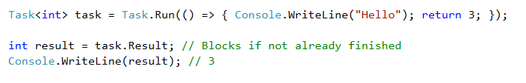
Returning values
Result can be obtained by querying the Result property from task.
If the task hasn’t yet finished, accessing this property will block the current thread until the task finishes

Slide 13
TaskCompletionSource
TaskCompletionSource provides a way to construct a task that does not in itself run any code, but is used as a notification mechanism for completion of some operation.
The real power of TaskCompletionSource is in creating tasks that don’t tie up threads.
Examples with source code are available AsynchronyThreadingDemo application (options 10-11)
Notes:
TaskCompletionSource is just a wrapper for a Task, giving you control over its completion.

Slide 14
Asynchronous programming
With asynchronous programming, you can divide your logic into awaitable tasks, where you can perform some long running operations such as reading large file without having to block the execution of your application on UI or service.
.NET framework gives you simple and easy to use keywords which are the async and await modifiers to transform your code from synchronous to asynchronous.
How this work?
Call an async method separately by obtaining a task object to it, then do some unrelated work, and after that await that task, either it has already finished which will result in returning the value from the task and then using it in next statements, or if it has not finished yet, then the execution will go back to the caller of the async method, and the program will execute normally without blocking the UI or the running service, and then once the task is done, it will proceed with the rest of the async method and return
Notes:
For every async method, the .NET framework will create a state machine to keep track of the calls and what should be done after the awaitable task has complete.
https://weblogs.asp.net/dixin/understanding-c-sharp-async-await-1-compilation
Why Implement Asynchronous Programming?
Asynchronous programming doesn't improve performance, it improves throughput.
Say we have a restaurant. In this restaurant, when orders are placed, they are delivered to the kitchen for cooking. The kitchen has a bunch of cooks whose job it is to make the food needed for each order. There are two kinds of kitchens we can use: synchronous, and asynchronous.
In a synchronous kitchen, each cook gets one order at any given time. They must then work that order to completion entirely on their own. That means that if an item needs to go in the oven, they will stare intently into it wait patiently while the item is cooking and not do anything else during that time. Hence this kitchen can handle only X amount of orders simultaneously, where X is the number of cooks in the kitchen.
In an asynchronous kitchen, cooks will not have idle time. They may receive an order, and start to make it, but if there comes a point at which they must wait for something to be done (cooking in the oven, etc.) they must go and do something else. This kitchen can handle significantly more orders than they have cooks, because no cook will ever be standing around waiting for something to happen. In this way, the number of orders fulfilled (aka the throughput) of the kitchen increases, even though each cook doesn't actually work any faster than they normally do.

Slide 15
Asynchronous programming
Throughout awaiting process, a key takeaway is that no thread is dedicated to running the task. There is no thread dedicated to waiting for data from the request to come back.
This allows the system to handle a much larger volume of work rather than waiting for some I/O call to finish.
Responsiveness is the biggest gain for both, client and server sides

Slide 16
Asynchronous programming
There are 3 patterns for asynchronous programming: Asynchronous Programming Model (APM) pattern, Event-based Asynchronous Pattern (EAP) and the most recent one, Task-based Asynchronous Pattern (TAP).
Currently, it is recommended to only follow the Task-based Asynchronous Pattern whenever you want to have an asynchronous implementation in your application
Use async / await feature to further enhance the structure of your application and increase throughput and responsiveness
Examples with source code are available AsynchronyThreadingDemo application (options 12-14)
Notes:
What asynchronous programming truly does is increase the amount of requests that can be handled at the same time with the same resources. The same amount of threads can handle many more simultaneous requests in an asynchronous system than in a synchronous one. In short, Asynchronous programming improves throughput.

Slide 17
Task-based asynchronous pattern (TAP)
TAP uses a single method to represent the initiation and completion of an asynchronous operation
A TAP method returns either Task or Task<T>, based on whether the corresponding synchronous method returns void or a type T
out and ref parameters should be avoided.
If a TAP method internally uses a task’s constructor to instantiate the task to be returned, the TAP method must call Start on the Task object before returning it.
TAP supports cancellation and progress reporting
Examples with source code are available AsynchronyThreadingDemo application (option 14)
Notes:
Any data that would have been returned through an out or ref parameter should instead be returned as part of the TResult returned by Task<TResult>, and should use a tuple or a custom data structure to accommodate multiple values.

Slide 18
Understanding async / await
The “async” keyword enables the “await” keyword in method and changes how method results are handled.
That’s all the async keyword does! It does not run this method on a thread pool thread, or do any other kind of magic
The beginning of an async method is executed just like any other method. That is, it runs synchronously until it hits an “await”
The “await” keyword is where things can get asynchronous. Await takes a single argument, an awaitable (“awaitable” is an asynchronous operation). Await examines that awaitable to see if it has already completed; if the awaitable has already completed, then the method just continues running (synchronously, just like a regular method)
If “await” sees that the awaitable has not completed, then it acts asynchronously. It tells the awaitable to run the remainder of the method when it completes, and then returns from the async method.
Notes:
Using await allows your application or service to perform useful work while a task is running by yielding control to its caller until the task is done. Your code does not need to rely on callbacks or events to continue execution after the task has been completed. The language and task API integration does that for you.

Slide 19
Understanding async / await
Later on, when the awaitable completes, it will execute the remainder of the async method. If you’re awaiting a built-in awaitable (such as a task), then the remainder of the async method will execute on a “context” that was captured before the “await” returned.
The async method pauses until the awaitable is complete (so it waits), but the actual thread is not blocked (so it’s asynchronous).

Slide 20
Understanding async / await
The await keyword simplifies the attaching of continuations. Compiler expands
var result = await expression;
statement();
Into something functionally similar to:
var awaiter = expression.GetAwaiter();
awaiter.OnCompleted(() =>
{
var result = awaiter.GetResult();
statement();
});

Slide 21
Understanding async / await
Earlier we mentioned: when you await a built-in awaitable, then the awaitable will capture the current context and later apply it to the remainder of the async method. What exactly is that context?
Simple answer is:
  If you’re on a UI thread, then it’s a UI context.
  If you’re responding to an ASP.NET request, then it’s an ASP.NET request context.
  Otherwise, it’s usually a thread pool context.
Complex answer:
  If SynchronizationContext.Current is not null, then it’s the current SynchronizationContext. (UI and ASP.NET request contexts are SynchronizationContext contexts).
  Otherwise, it’s the current TaskScheduler (TaskScheduler.Default is the thread pool context).
Notes:
Context behavior can also cause another problem—one of performance.
As asynchronous UI applications grow larger, you might find many small parts of async methods all using the UI thread as their context.
To mitigate this, await the result of ConfigureAwait whenever you can. By using ConfigureAwait, you enable a small amount of parallelism: Some asynchronous code can run in parallel with the UI thread instead of constantly badgering it with bits of work to do.
Aside from performance, ConfigureAwait has another important aspect: It can avoid deadlocks.

Slide 22
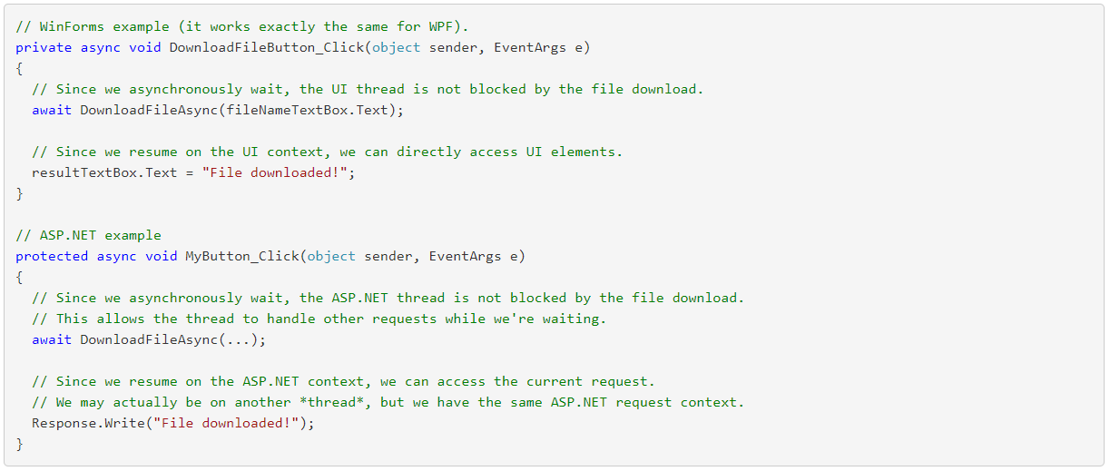
Understanding async / await

Slide 23
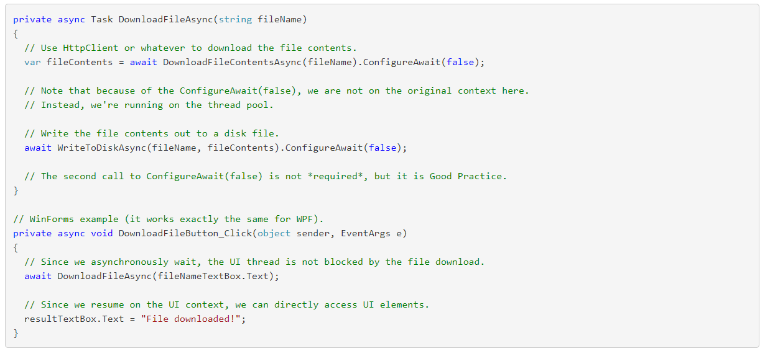
Understanding async / await
What if we don’t want to capture the current context?
Notes:
The important thing to note with this example is that each “level” of async method calls has its own context.
DownloadFileButton_Click started in the UI context, and called DownloadFileAsync.
DownloadFileAsync also started in the UI context, but then stepped out of its context by calling ConfigureAwait(false). The rest of DownloadFileAsync runs in the thread pool context. However, when DownloadFileAsync completes and DownloadFileButton_Click resumes, it does resume in the UI context.
A good rule of thumb is to use ConfigureAwait(false) unless you know you do need the context

Slide 24
Understanding async / await
If every async method need to have an await inside of it, and a await can only be done on a methods with async, when does it stop?
await is not applied to methods. What happens is the method is called and returns something (e.g., a Task), and then the await is applied to that task.
So, the misunderstanding is here: await is applied to awaitables (e.g., tasks), not methods.
It must end somewhere, with an await being applied to a non-async method?
Yes. Any method can return a Task (or any awaitable), whether it's async or not.
Notes:
A method can use async to construct its task (and most of the methods we write do it this way), but it can also build one directly.
Usually, low-level asynchronous methods use TaskFactory.FromAsync or TaskCompletionSource<T> to create their task that they return.

Slide 25
Guidelines for async/await
Consider some of new await-friendly techniques that should be used instead of the old blocking techniques
To do this… | Instead of this… | Use this
Retrieve the result of a background task | Task.Wait or Task.Result | await
Wait for any task to complete | Task.WaitAny | await Task.WhenAny
Retrieve the results of multiple tasks | Task.WaitAll | await Task.WhenAll
Wait a period of time | Thread.Sleep | await Task.Delay
Create a code-based task | Task constructor | Task.Run
Notes:
To create code-based task we can use also TaskFactory.StartNew

Slide 26
Guidelines for async/await
Avoid using async void
Don’t mix asynchronous code with synchronous
Using synchronous code in asynchronous API
Don’t create a fake asynchronous method
Don’t capture the current context when it’s not needed
Avoid using await inside of foreach loop
Notes:
http://hamidmosalla.com/2018/04/21/top-7-common-async-mistakes/
https://rubikscode.net/2018/05/28/asynchronous-programming-in-net-common-mistakes-and-best-practices/

Slide 27
Synchronization
Synchronization is the act of coordinating concurrent actions for a predictable outcome.
The synchronization constructs can be divided into three categories:
  Exclusive locking
    Exclusive locking constructs allow just one thread to perform some activity or execute a section of code at a time. Their primary purpose is to let threads access shared writing state without interfering with one other. The exclusive locking constructs are lock, Mutex, and SpinLock.
  Nonexclusive locking
    Nonexclusive locking lets you limit concurrency. The nonexclusive locking constructs are Semaphore(Slim) and ReaderWriterLock(Slim).
  Signaling
    These allow a thread to block until receiving one or more notifications from other thread(s). The signaling constructs include ManualReset Event(Slim), AutoResetEvent, CountdownEvent, and Barrier.
Notes:
The simplest and most useful synchronization tools are arguably the continuations and task combinators.

Slide 28
Locking and thread safety
A program or method is thread-safe if it can work correctly in any multithreading scenario. Thread safety is achieved primarily with locking and by reducing the possibilities for thread interaction.
As a basic rule, you need to lock around accessing any writable shared field. Even in the simplest case - an assignment operation on a single field - you must consider synchronization.
Any object visible to each of the partaking threads can be used as a synchronizing object, subject to one hard rule: it must be a reference type.
Locking doesn’t restrict access to the synchronizing object itself in any way. In other words, x.ToString() will not block because another thread has called lock(x)
Notes:
C#’s lock statement is in fact a syntactic shortcut for a call to the methods Monitor.Enter and Monitor.Exit with a try/finally block.

Slide 29
Locking and thread safety
Deadlocking is one of the hardest problems in multithreading - especially when there are many interrelated objects.
Fundamentally, the hard problem is that you can’t be sure what locks your caller has taken out.
Relying more on higher-level synchronization options such as task continuations/combinators, data parallelism, and immutable types can lessen the need for locking.
Notes:
static object object1 = new object();
static object object2 = new object();
public static void ObliviousFunction()
{
lock (object1)
{
Thread.Sleep(1000); // Wait for the blind to lead
lock (object2)
{
}
}
}
public static void BlindFunction()
{
lock (object2)
{
Thread.Sleep(1000); // Wait for oblivion
lock (object1)
{
}
}
}
static void Main()
{
Thread thread1 = new Thread((ThreadStart)ObliviousFunction);
Thread thread2 = new Thread((ThreadStart)BlindFunction);
thread1.Start();
thread2.Start();
while (true)
{
// Stare at the two threads in deadlock.
}
}

Slide 30
Mutex and lazy initialization
A Mutex is like a C# lock, but it can work across multiple processes.
In other words, Mutex can be computer-wide as well as application-wide
A frequent problem in threading is how to lazily initialize a shared field in a thread safe fashion. The need arises when you have a field of a type that’s expensive to construct in terms of performance.
Lazy<Expensive> _expensive = new Lazy<Expensive> (() => new Expensive(), true);
public Expensive Expensive { get { return _expensive.Value; } }
To use Lazy<T>, instantiate the class with a value factory delegate that tells it how to initialize a new value. Boolean parameter specifies do we want thread-safe or thread-unsafe lazy initialization.
Notes:
Expensive _expensive;
readonly object _expenseLock = new object();
public Expensive Expensive
{
get
{
lock (_expenseLock)
{
if (_expensive == null) _expensive = new Expensive();
return _expensive;
}
}
}

Slide 31
Parallel programming
Over the past 10 years, CPU manufacturers have shifted from single- to multicore processors. This is problematic for us as programmers because single-threaded code does not automatically run faster as a result of those extra cores.
Leveraging multiple cores is easy for most server applications, where each thread can independently handle a separate client request, but is harder on the desktop - because it typically requires that you take your computationally intensive code and do the following:
  Partition it into small chunks.
  Execute those chunks in parallel via multithreading
  Collate the results as they become available, in a thread-safe and performant manner.

Slide 32
Data and task parallelism
There are two strategies for partitioning work among threads: data parallelism and task parallelism.
When a set of tasks must be performed on many data values, we can parallelize by having each thread perform the (same) set of tasks on a subset of values. This is called data parallelism because we are partitioning the data between threads.
In contrast, with task parallelism we partition the tasks. In other words, we have each thread perform a different task.
Notes:
Data parallelism is also conducive to structured parallelism, which means that parallel work units start and finish in the same place in your program.
In contrast, task parallelism tends to be unstructured, meaning that parallel work units may start and finish in places scattered across your program.

Slide 33
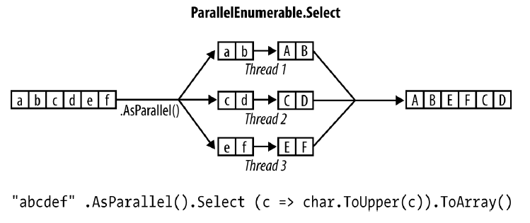
When to use Parallel Framework (PFX)?
The primary use case for PFX is parallel programming: leveraging multicore processors to speed up computationally intensive code.
Before proceeding, it’s worth verifying that the bottleneck is in parallelizable code.
Notes:
Calling AsSequential() unwraps a ParallelQuery sequence so that subsequent query operators bind to the standard query operators and execute sequentially.
This is necessary before calling methods that have side effects or are not thread-safe.
You don’t, however, need to keep applying AsParallel to a query as it progresses, because PLINQ’s query operators output another ParallelQuery sequence.
In fact, calling AsParallel again introduces inefficiency in that it forces merging and repartitioning of the query:
mySequence.AsParallel() // Wraps sequence in ParallelQuery<int>
.Where (n => n > 100) // Outputs another ParallelQuery<int>
.AsParallel() // Unnecessary - and inefficient!
.Select (n => n * n)
When to Use PLINQ
----------------------
It’s tempting to search your existing applications for LINQ queries and experiment with parallelizing them. This is usually unproductive, because most problems for which LINQ is obviously the best solution tend to execute very quickly and so don’t
benefit from parallelization. A better approach is to find a CPU-intensive bottleneck and then consider, “Can this be expressed as a LINQ query?” (A welcome side effect of such restructuring is that LINQ typically makes code smaller and more readable.)
PLINQ is well suited to embarrassingly parallel problems. It can be a poor choice for imaging, however, because collating millions of pixels into an output sequence
creates a bottleneck. Instead, it’s better to write pixels directly to an array or unmanaged
memory block and use the Parallel class or task parallelism to manage the
multithreading.

Slide 34
PLINQ
Like ordinary LINQ queries, PLINQ queries are lazily evaluated. This means that execution is triggered only when you begin consuming the results - typically via a foreach loop
A side effect of parallelizing the query operators is that when the results are collated, it’s not necessarily in the same order that they were submitted.
If you need order preservation, you can force it by calling AsOrdered() after AsParallel()
Notes:
Calling AsOrdered incurs a performance hit with large numbers of elements because PLINQ must keep track of each element’s original position.
You can negate the effect of AsOrdere later in a query by calling AsUnordered: this introduces a “random shuffle point” that allows the query to execute more efficiently from that point on.

Slide 35
PLINQ partitioning strategies
PLINQ has three partitioning strategies for assigning input elements to threads:
  Chunk partitioning
  Range partitioning
  Hash partitioning
For query operators that require comparing elements (GroupBy, Join, GroupJoin, Intersect, Except, Union, and Distinct), you have no choice: PLINQ always uses hash partitioning.
For all other query operators, you have a choice as to whether to use range or chunk partitioning.
Notes:
For all other query operators, you have a choice as to whether to use range or chunk partitioning. By default:
• If the input sequence is indexable (if it’s an array or implements IList<T>), PLINQ chooses range partitioning.
• Otherwise, PLINQ chooses chunk partitioning
In a nutshell, range partitioning is faster with long sequences for which every element takes a similar amount of CPU time to process. Otherwise, chunk partitioning is usually faster.
To force range partitioning:
• If the query starts with Enumerable.Range, replace that method with ParallelEnumerable.Range.
• Otherwise, simply call ToList or ToArray on the input sequence (obviously, this incurs a performance cost in itself that you should take into account).

Slide 36
PLINQ partitioning strategies

Slide 37
Parallel class
Parallel.For and Parallel.ForEach usually work best on outer rather than inner loops. This is because with the former, you’re offering larger chunks of work to parallelize, diluting the management overhead.
Parallelizing both inner and outer loops is usually unnecessary.
Just as with PLINQ, the Parallel.* methods are optimized for compute-bound and not I/O-bound work.

Slide 38
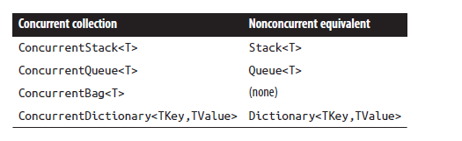
Concurrent Collections
A thread-safe collection doesn’t guarantee that the code using it will be thread safe
If you enumerate over a concurrent collection while another thread is modifying it, no exception is thrown—instead, you get a mixture of old and new content.
There’s no concurrent version of List<T>
Examples with source code are available AsynchronyThreadingDemo application (option 15)
Notes:
You still need to be very careful when using thread-safe collections because thread-safe doesn't mean you can ignore all threading issues.
When a collection advertises itself as thread-safe, it usually means that it remains in a consistent state even when multiple threads are reading and writing simultaneously. But that does not mean that a single thread will see a "logical" sequence of results if it calls multiple methods. For example, if you first check if a key exists and then later get the value that corresponds to the key, that key may no longer exist even with a ConcurrentDictionary version (because another thread could have removed the key). You still need to use locking in this case (or better: combine the two calls by using TryGetValue).
So do use them, but don't think that it gives you a free pass to ignore all concurrency issues. You still need to be careful.

Slide 39
ConcurrentBag<T>
ConcurrentBag<T> stores an unordered collection of objects (with duplicates permitted)
ConcurrentBag<T> is suitable in situations when you don’t care which element you get when calling Take or TryTake.
Inside a concurrent bag, each thread gets its own private linked list. Elements are added to the private list that belongs to the thread calling Add.
When you enumerate over the bag, the enumerator travels through each thread’s private list, yielding each of its elements in turn
When you call Take, the bag first looks at the current thread’s private list. If there’s at least one element it can complete the task easily and without contention. But if the list is empty, it must “steal” an element from another thread’s private list and incur the potential for contention.
So, to be precise, calling Take gives you the element added most recently on that thread; if there are no elements on that thread, it gives you the element added most recently on another thread, chosen at random

Slide 40
References
C# 7.0 in a Nutshell – Joseph Albahari & Ben Albahari
https://docs.microsoft.com/en-us/dotnet/csharp/async
https://docs.microsoft.com/en-us/dotnet/standard/async
http://blog.stephencleary.com
https://www.codingame.com/playgrounds/4240/your-ultimate-async-await-tutorial-in-c/introduction
https://exceptionnotfound.net/asynchronous-programming-in-asp-net-csharp-ultimate-guide/
http://hamidmosalla.com/2018/04/21/top-7-common-async-mistakes/
https://rubikscode.net/2018/05/28/asynchronous-programming-in-net-common-mistakes-and-best-practices/

